Slide 1
GUDLAVALLERU ENGINEERING COLLEGE
Smart aquarium based on IOT
PRESENTED BY:
19485A0425(Suguna sri Chandana)
19485A0426(Pradeep Kumar)
19485A0427(Kuna Sai Ganesh)
19485A04284 (Vinathi Hrudai)
19485A0429 (Munnangi Suneetha)
TEAM NAME:ECE_C12

Slide 2
CONTENTS
Introduction
Problem statement
Problem solution
Advantages
Conclusion

Slide 3
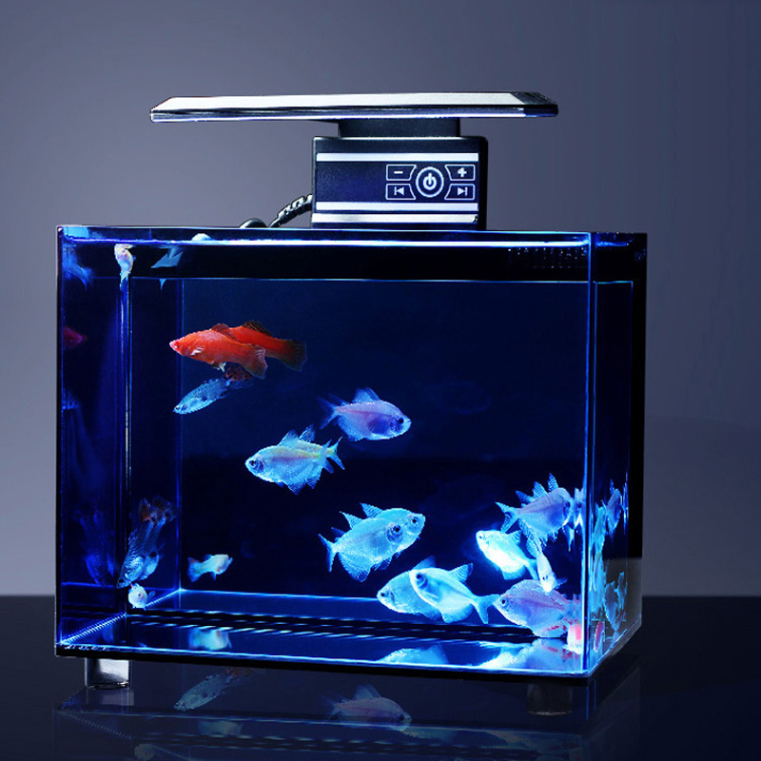
INTRODUCTION

Slide 4
PROBLEM STATEMENT
It is difficult to feed the fishes in the absence of fishkeepers.
Inspect the temperature and salinity of water.
Continuous monitoring and controlling.

Slide 5
PROBLEM SOLUTION
Main objective is to setup an aquarium.
Monitoring the waterlevel via internet.
Feeding the fishes using servomotor.
Random data to detect the waterflow.
Mobile application.

Slide 6
Advantages:
Time saving.
Maintains the aquarium temperature.
Auto fish feeding.
Notifications in case of trouble.

Slide 7
CONCLUSION
The proposed system for the control of aquarium using mobile app has been implemented.
It can easily implemented for making life of aquarists more comfortable.
It is user friendly system which can be accessed remotely using mobile phone

Slide 8


